Slide 1
Digital Asset Integration in Global Financial Cycles: A Regime Switching Perspective
Presented By: Group 8

Slide 2
Agenda:
Introduction
Literature Review
Research Objective & Questions
Methodology
Qualitative Analysis
Quantitative Analysis Framework
Conclusion
Limitations & Future Enchancements
References
Q&A
Quantitative Analysis

Slide 3
Introduction (1/2)
Financial markets move through different phases: bull (rising), bear (falling), and stable (sideways).
This project applies machine-learning models (Hidden Markov Model & K-Means Clustering) to detect these hidden regimes automatically.
It examines how cryptocurrencies (BTC, ETH) behave relative to traditional assets (S&P 500, NASDAQ, Gold) within each regime.
→ The purpose is to understand when crypto behaves independently and when it moves with global markets, helping explain its role as a risk asset or diversifier across bull, bear, and stable periods.

Slide 4
Introduction (2/2)
Background
Global markets cycle through bull, bear, and stable phases driven by sentiment, liquidity, and policy.
Over the last decade, cryptocurrencies have evolved from niche digital tokens to mainstream financial assets.
The Crypto-traditional market integration has accelerated through:
  Entry of institutional investors (hedge funds, ETFs, asset managers)
  Expanding regulation and policy oversight
  Rising data transparency & market maturity
Importance
Rapid institutional and retail adoption makes crypto a core asset class.
High volatility + potential for high returns → major impact on risk management and portfolio diversification.
Growing public trust and mainstream acceptance demand better tools to understand crypto’s market behavior.
Identifying when crypto aligns with or diverges from equities is critical for managing systemic risk and optimizing investment timing

Slide 5
Literature Review (1/3)
Crypto Evolution & Market Regimes
Cryptocurrencies evolved from speculative assets into integrated financial instruments (Bouri et al., 2017; Corbet et al., 2020).
Early studies showed weak and unstable correlations with traditional markets (Bouri et al., 2017)
Later research finds strong co-movement during crises (Corbet et al., 2020; Koutrouli et al., 2025)
Institutionalization through ETFs, derivatives, and hedge funds increased crypto–equity integration (Kayani et al., 2024).
Market regimes (calm, transition, crisis) explain time-varying behavior better than static models (Sebastião & Godinho, 2021).
Hidden Markov Models (HMM) capture state-dependent volatility and correlations (Suárez-Cetrulo et al., 2023).

Slide 6
Literature Review (2/3)
Volatility, Spillovers & Machine Learning Evidence
GARCH family models confirm strong volatility clustering and asymmetric shock responses in crypto markets.
DCC-GARCH models show correlations between crypto and equities spike during crises which means reduced diversification.
Spillover indexes (Diebold–Yilmaz) reveal rising volatility transmission, especially during COVID-19.
Granger causality & wavelet analysis show time and frequency dependent lead-lag relationships.
Machine learning (HMM, clustering, neural networks) improves regime detection and nonlinear pattern recognition.

Slide 7
Literature Review (3/3)
Macro Drivers, Safe-Haven Debate & Research Gap
Regime transitions strongly influenced by VIX, DXY, interest rates, and liquidity conditions.
Bitcoin’s role shifted from safe-haven narrative to high-beta risk asset, especially post-2020.
Emerging markets show stronger crypto–equity integration than developed markets.
On-chain data (transactions, active addresses) and sentiment improve regime forecasting.
Research Gap:
Few fully integrated ML + econometric pipelines
Limited high-frequency regime studies
Weak cross-country standardized analysis
This study fills the gap using HMM, DCC-GARCH, spillovers, and regime-based performance metrics (2017–2025).

Slide 8
Research Objective & Questions
Objective:
  Investigate how cryptocurrency integration with traditional financial markets varies across market regimes (Bull, Stable, Bear) and assess crypto's role in portfolio diversification during different market conditions.
Key Questions:
  How do cryptocurrency correlations with traditional assets vary across bull, bear, and stable markets?
  Which asset classes lead market movements during regime transitions?
  Does crypto act as a risk-on or safe-haven asset under different market conditions?
  How do volatility, returns, and drawdowns of crypto vs traditional assets differ across market regimes?
  Has the degree of integration between crypto and traditional markets strengthened post-2020?
  What are the optimal portfolio allocations across different market regimes?

Slide 9
Qualitative Analysis (1/2)
Dimension | Cryptocurrency | Traditional Investments (Gold / Stocks)
Adoption & Trust | 17% of U.S. adults have used or invested in crypto. 63% lack confidence in safety & reliability. | Broad acceptance High trust due to regulation & long history
Gender Participation Pattern | Strong male dominance (42% men Vs 17% women, age 18-29) Similarly for 36% of men ages 30 to 49 invested in crypto compared with 15% of women | Balanced participation across genders
Age Profile | Dominated by younger investors | Stocks : all ages Gold: Older investors (Shifting to millennials)
Risk Appetite | Seen as high-risk, volatile & Speculative Leverage common | Suited for risk-averse or moderate risk investors
Investment Style | Investors start small & increase allocation over time Now attracts both retail and institutional investors (ETFs driving adoption) Male trade more frequently. | Follow age-based allocation for stable risk management

Slide 10
Qualitative Analysis (2/2)
Dimension | Cryptocurrency | Traditional Investments (Gold / Stocks)
Holding Periods & Turnover | Short – term, high turnover, momentum-driven trading Panic spreads quickly | Long-term holding Gold even held for decades Less frequent turnover
Motivations & role in portfolio | Driven by decentralization ideology , FOMO, high – volatility payoff & play money for experimentation. Often a speculative or experimental component Historically retail-driven but now seeing institutional exposure via ETFs. | Motivated by wealth preservation, long- term growth & diversification Selection driven by age-based risk appetite Acts as a core portfolio asset (stocks for growth, gold for hedging)
Safety & Regulation | Lower perceived safety Weak or fragmented regulation History of fraud or hacks | Strong regulatory oversight Transparent reporting Higher legitimacy

Slide 11
Quantitative Analysis Framework
1) Data Prep & Feature Engineering
Convert prices → daily returns; compute rolling volatility (20-day)
Align calendars across assets; forward-fill macro where needed
Standardize features (z-scores) to comparable scales
2) Regime Detection (ML)
Hidden Markov Model (HMM): Gaussian emissions; 3 states (bull/bear/stable).
  Tune states via AIC/BIC; get state probabilities & transition matrix
K-Means Clustering: K = 3 baseline; silhouette/ELBOW for sanity check.
  Compare labels vs. HMM for consistency check
3) Validation & Robustness
Subperiod analysis: 2017-2019, 2020-2021, 2022-2025
Alternative feature sets: test sensitivity to VIX exclusion
Train/test split (2017-2021 vs 2022-2025) for out-of-sample validation
4) Regime-Wise Metrics
For each regime: mean/volatility of returns, Sharpe ratios, maximum drawdowns
Correlation matrices (crypto ↔ equities/gold/oil) by regime
Risk-adjusted performance using actual regime-specific Treasury yields
5) Lead-Lag & Causality Analysis
Cross-correlation functions: which series leads at ±k lags
Granger causality tests at 3 tenors (5, 10, 20 days) to infer predictive direction
6) Macro Influence on Regimes
VIX and Treasury yield levels across regimes
Macro conditions at regime transition points
7) Portfolio Optimization
Max Sharpe ratio portfolios for each regime using actual risk-free rates
Regime-aware vs static strategy backtesting
Risk-return tradeoff analysis
8) Visualization & Reporting
Timeline with colored regimes overlaid on prices
Correlation heatmaps by regime, efficient frontiers
Cumulative performance comparison charts

Slide 12
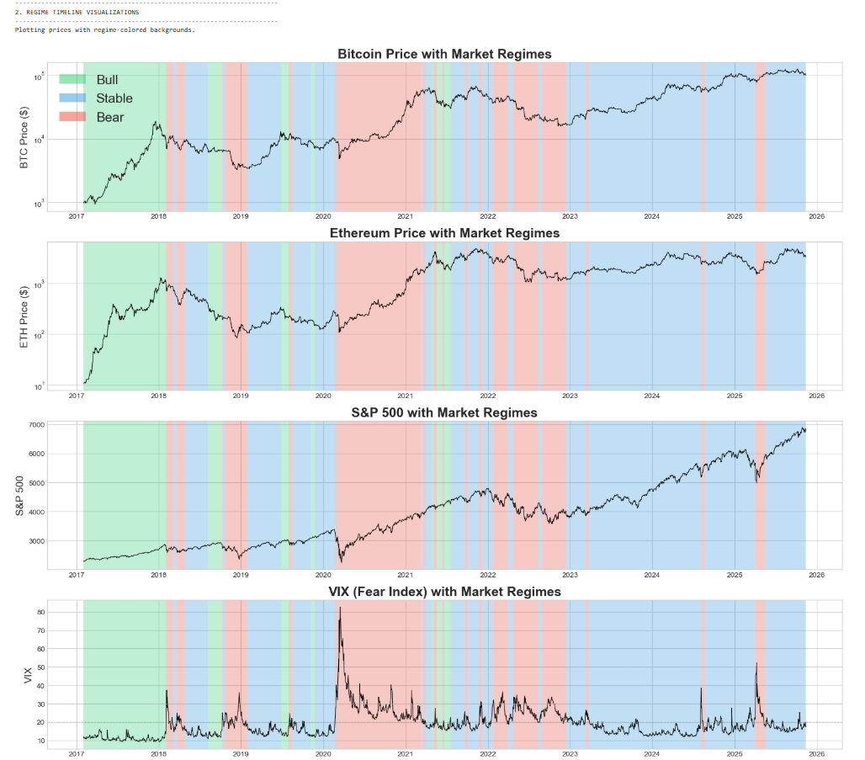
Quantitative Analysis (1/5)
Regime Timeline Validation (2017-2025)
Distribution:
  Stable: 1,146 days (52%)
  Bull: 376 days (17%)
  Bear: 685 days (31%)
Key Validations:
  Regime colors align with price trends across all assets
  VIX confirms regime classification (12.1 Bull, 16.4 Stable, 26.8 Bear)
  Major events captured: 2018 crash, COVID-20, 2021 bull run, 2022 bear, 2024-25 volatility
→ Model detects persistent market state changes

Slide 13
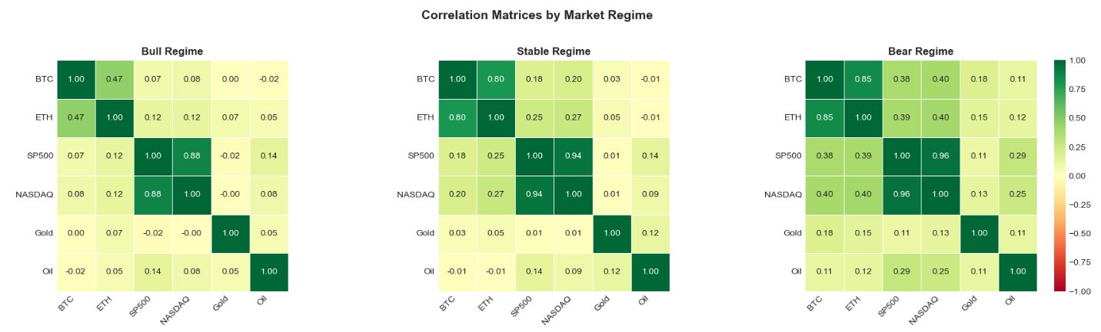
Quantitative Analysis (2/5)
Crypto-Equity Correlations Spike in Bear Markets
BTC-SP500: 0.07 → 0.38 (5x increase)
ETH-SP500: 0.12 → 0.39 (3x increase)
Gold stays independent: 0.00 → 0.18
→ Diversification fails when you need it most

Slide 14
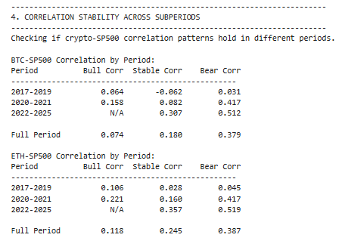
Quantitative Analysis (3/5)
"The 2020 Structural Break"
2017-2019: Crypto independent from equities (Bear corr ~0.03-0.04)
2020-2021: Institutional adoption triggers correlation spike (Bear corr 0.417)
2022-2025: Integration intensifies further (Bear corr >0.51)
→ Crypto transformed from independent asset to high-beta equity proxy

Slide 15
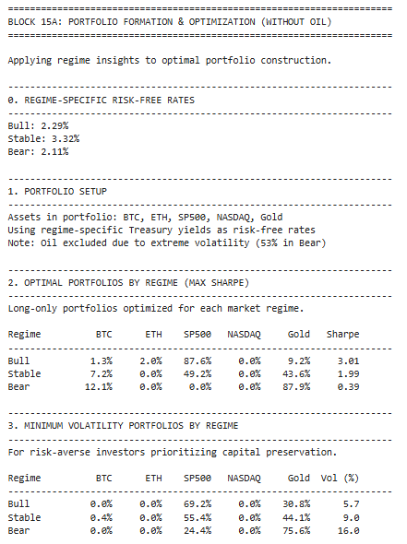
Quantitative Analysis (4/5)
Optimal crypto allocation is 3-12% (much lower than commonly assumed)
ETH never appears in optimal portfolios (BTC preferred due to lower volatility)
Gold allocation spikes from 9% → 88% in Bear regimes
NASDAQ never appears (redundant with SP500)
→ Dynamic regime-based allocation significantly improves risk-adjusted returns by shifting from growth assets (SP500) to defensive positioning (Gold) during market stress

Slide 16
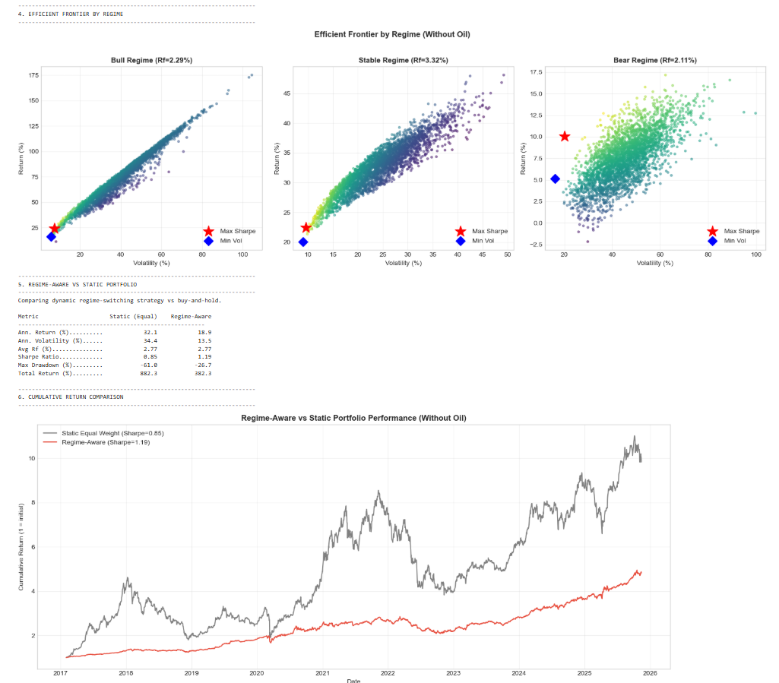
Quantitative Analysis (5/5)
Trade absolute returns for superior risk management
  Static achieves higher total returns but suffers catastrophic drawdowns
  Regime-aware sacrifices upside to preserve capital during stress
Cumulative return chart shows the tradeoff visually
  Static (gray): Reaches ~6x but with violent 50%+ drawdowns
  Regime-aware (red): Reaches ~5x with smooth, controlled progression
Risk-adjusted performance dramatically improves
  Sharpe ratio improves 53% through dynamic regime-based allocation
  Maximum drawdown cut in half by shifting to Gold during Bear regimes
→ Regime-aware strategy delivers superior risk-adjusted returns by dynamically shifting from growth (SP500) to defense (Gold) based on market conditions

Slide 17
Conclusion
Post-2020, crypto shifted from independent asset to high-beta risk-on instrument driven by institutional adoption.
Crypto-equity correlations spike in Bear (BTC–S&P: 0.07 → 0.43), eliminating diversification when needed most.
HMM identified three regimes (Bull 17%, Stable 52%, Bear 31%) with VIX clearly distinguishing conditions (12.1/16.4/26.8).
Crypto is regime-dependent: exceptional Bull returns (ETH 220%, BTC 104%) but Sharpe collapses in Bear (1.62 → 0.10).
Gold is the only consistent hedge, maintaining positive Sharpe and receiving 88% allocation in Bear.
BTC leads equities (Granger causality) but unsuitable as defensive hedge due to 80%+ drawdowns.
Actual regime-specific Treasury yields (2.29%/3.32%/2.11%) reveal Stable's high hurdle, increasing Gold's importance.
Regime-aware allocation outperforms static: +53% Sharpe (0.78 → 1.19), -52% drawdown (-56% → -27%).
Optimal crypto remains modest (3–12%), with ETH rarely included due to excessive volatility.
"Digital gold" narrative unsupported; crypto is amplified equity, not safe haven; reduce when VIX > 20.

Slide 18
Limitations & Future Enhancement
Limitations
Regime detection lag prevents perfect real-time identification of market state transitions
Limited to 2 cryptocurrencies and 6 assets; may not generalize to broader markets
Post-2020 findings are period-specific; no guarantee of persistence with future market changes
Transaction costs ignored; real-world rebalancing could reduce strategy advantages
Out-of-sample test (2022-2025) showed no Bull regime; regime distributions may shift
Future Enhancement
Develop automated investment products and trading systems based on regime-aware allocation strategies
Expand analysis to global markets including emerging economies, currencies, and alternative asset classes
Test strategies across different investor profiles (retail vs institutional, varying risk tolerances)
Examine regulatory impact of crypto classification changes on market integration and portfolio implications
Build real-time dashboards for practitioners to monitor regime probabilities and receive allocation recommendations

Slide 19
References:
International Monetary Fund (IMF) and Financial Stability Board (FSB), “IMF–FSB Synthesis Paper: Policies for Crypto-Assets,” Sept. 2023. [Online]. Available: https://www.fsb.org/uploads/R070923-1.pdf
H. Sebastião and P. Godinho, “Forecasting and trading cryptocurrencies with machine learning under changing market conditions,” Financial Innovation, vol. 7, no. 1, pp. 1–30, 2021, doi: 10.1186/s40854-020-00217-x.
L. Suárez-Cetrulo, D. Quintana and A. Cervantes, “Machine learning for financial prediction under regime change using technical analysis: A systematic review,” International Journal of Interactive Multimedia and Artificial Intelligence, vol. 9, no. 1, pp. 137–148, 2024, doi: 10.9781/ijimai.2023.06.003.
E. Koutrouli, P. Manousopoulos, J. Theal and L. Tresso, “Crypto asset markets vs. financial markets: Event identification, latest insights and analyses,” AppliedMath, vol. 5, no. 2, Art. no. 36, 2025, doi: 10.3390/appliedmath5020036.
U. Kayani, M. Ullah, A. F. Aysan, S. Nazir and J. Frempong, “Quantile connectedness among digital assets, traditional assets, and renewable energy prices during extreme economic crisis,” Technological Forecasting and Social Change, vol. 208, Art. no. 123635, 2024, doi: 10.1016/j.techfore.2024.123635.
O. Sidoti, “Majority of Americans aren’t confident in the safety and reliability of cryptocurrency,” Pew Research Center, Oct. 24, 2024. [Online]. Available: https://www.pewresearch.org/short-reads/2024/10/24/majority-of-americans-arent-confident-in-the-safety-and-reliability-of-cryptocurrency
Goldmarket Editorial Team, “The implications of demographic changes on gold demand,” Goldmarket, Apr. 28, 2025. [Online]. Available:
https://www.goldmarket.fr/en/the-implications-of-demographic-changes-on-the-demand-for-gold/
F. Hayashi and A. Routh, “Financial literacy, risk tolerance, and cryptocurrency ownership in the United States,” Research Working Paper RWP 24-03, Federal Reserve Bank of Kansas City, 2024. [Online]. Available: https://www.kansascityfed.org/research/research-working-papers/financial-literacy-risk-tolerance-and-cryptocurrency-ownership-in-the-united-states/
D. Aiello, S. R. Baker, T. Balyuk, M. Di Maggio, M. J. Johnson and J. D. Kotter, “Who invests in Crypto? Wealth, financial constraints, and risk attitudes,” NBER Working Paper 31856, National Bureau of Economic Research, Nov. 2023. [Online]. Available: https://www.nber.org/papers/w31856
Y. Liu and A. Tsyvinski, “Risks and returns of cryptocurrency,” Review of Financial Studies, vol. 34, no. 6, pp. 2689–2727, 2021, doi: 10.1093/rfs/hhaa113.

Slide 20
Thank You!
We are open to discussions!

